Slide 1

Quantium Retail Analytics
Customer Segmentation & Purchasing Behavior Analysis — Chips Category

Slide 2
Agenda
01
02
03
Project Scope & Data Overview
Sales & Store Performance
Product & Customer Analysis
Problem statement, objectives, and methodology
Financial trends, MoM changes, and top-performing stores
Top products, transaction behavior, and purchasing patterns
04
05
RFM Segmentation
Recommendations
Customer segments, revenue contribution, and behavioral insights
Data-driven strategies to drive category growth and revenue

Slide 3

Project Overview
Problem
Value
Category management needs a deeper understanding of customer segments purchasing chips and their associated buying behaviors to drive strategic decisions.
Enables more effective pricing strategies through price sensitivity analysis, and powers targeted promotions focused on high-value, high-frequency customers.
Solution
Python and SQL were used to analyze transaction and customer data, identify behavioral segments, visualize insights with Matplotlib, and generate actionable recommendations.

Slide 4
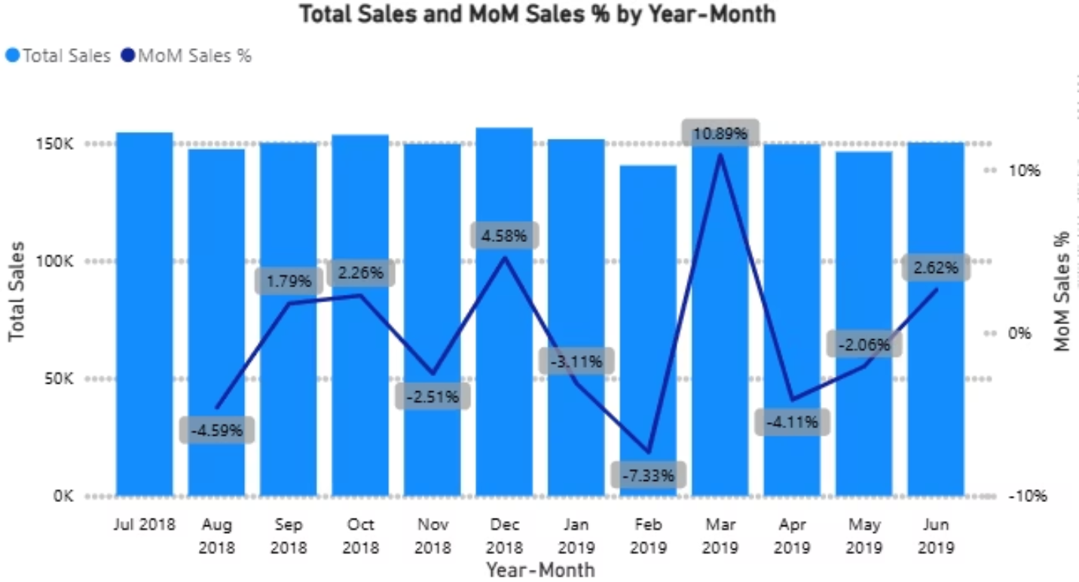
Overall Financial Trend
Stable Baseline
Sales averaged ~$150K/month, peaking at $156,461 — a solid, consistent floor with seasonal upside.
February Dip → March Surge
A –7.33% MoM dip in February reversed sharply to +10.89% MoM in March, pointing to an effective promotional initiative.
Seasonal Peak
December sales spiked, driven by the Christmas festive season — customers shopping well above their typical cadence.
Volatility Signal
Overall trend is short-term driven — promotions and seasonality dominate rather than structural organic growth.

Slide 5

Customer Purchasing Behavior Overview
$7.32
1.91
19.6K
51.7K
Avg. Sales per Transaction
Avg. Units per Transaction
One-Time Customers
Repeat Customers
Avg. spend of $6.45 per transaction — low engagement, high churn risk
Avg. spend of $32.46 — 5× higher than one-time buyers, underscoring retention value
Consistent baseline spend across the customer base
Approximately 2 packs per visit on average
Repeat customers represent the highest-value cohort. Strategies that convert one-time buyers into repeat purchasers will have an outsized impact on category revenue.

Slide 6
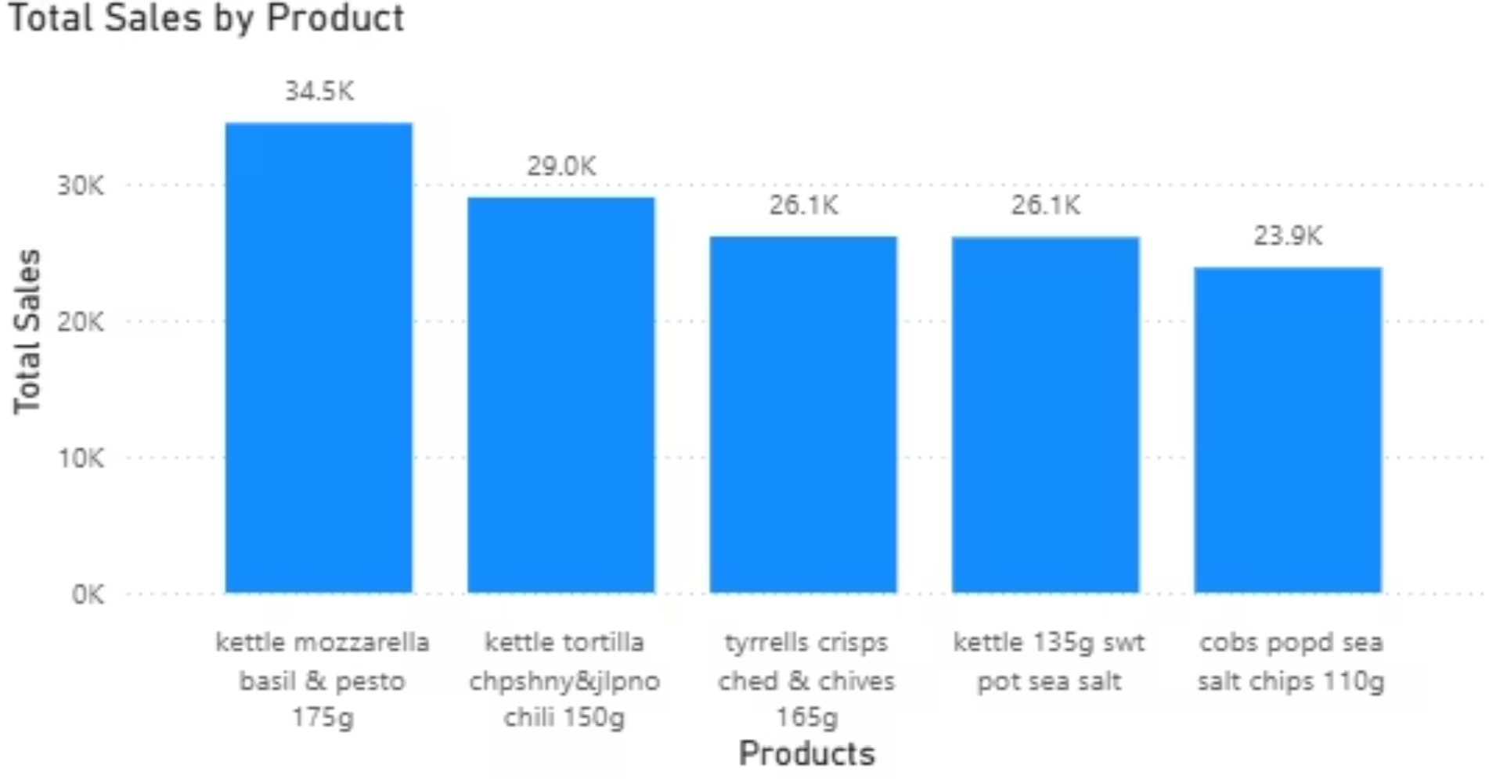
Product Analysis — Top 5 by Total Sales
Key Takeaways
Kettle Mozzarella Basil & Pesto 175g leads all products with $34.5K in total sales — the clear category favorite.
The Kettle brand dominates, contributing 64% of total sales across the top 5 products.
Cobs Popped Sea Salt Chips 110g rounds out the top 5 at $23.9K, showing strong performance in the lighter snack segment.
Increasing shelf space and promotional support for Kettle brand SKUs represents a clear revenue lever.

Slide 7
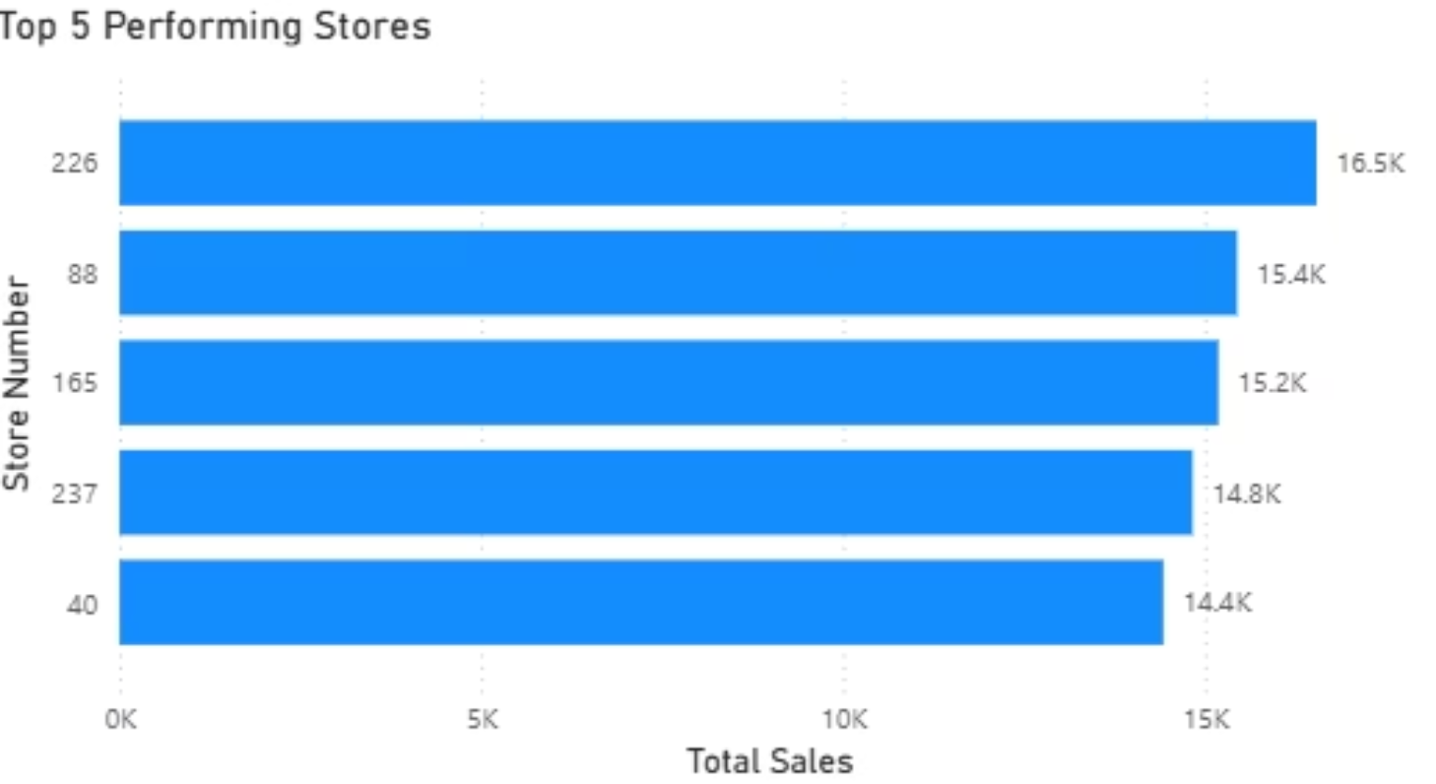

Top Performing Stores — Sales Overview
Performance Summary
Store 226 is the standout leader at $16.5K — a $1K gap above the next four stores, all clustered between $14.4K–$15.4K.
Stores 88 and 165 are nearly tied ($200 apart), and stores 237 and 40 are separated by just $400 — indicating stable, predictable mid-tier performance.
The narrow performance band means incremental improvements to mid-tier stores could generate meaningful revenue uplift at low investment.
Benchmark mid-performing stores against Store 226's merchandising and placement practices to close the gap.

Slide 8
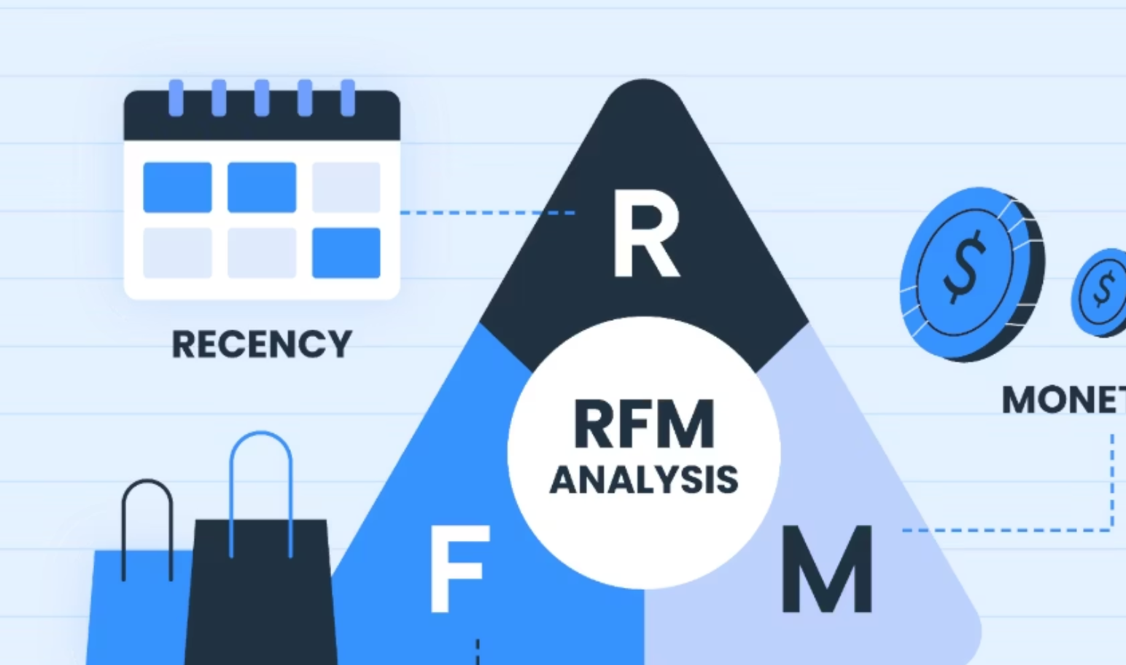
RFM Analysis Framework
Recency (R)
How recently did a customer last purchase? Higher recency signals active engagement.
Frequency (F)
How often does a customer purchase? Frequency distinguishes loyal shoppers from occasional ones.
Monetary (M)
What is the total value of purchases? Monetary value identifies the highest-revenue customers.
Outcome
RFM shifts the chip category from broad promotions to data-driven targeting, improving retention and long-term profitability.

Slide 9
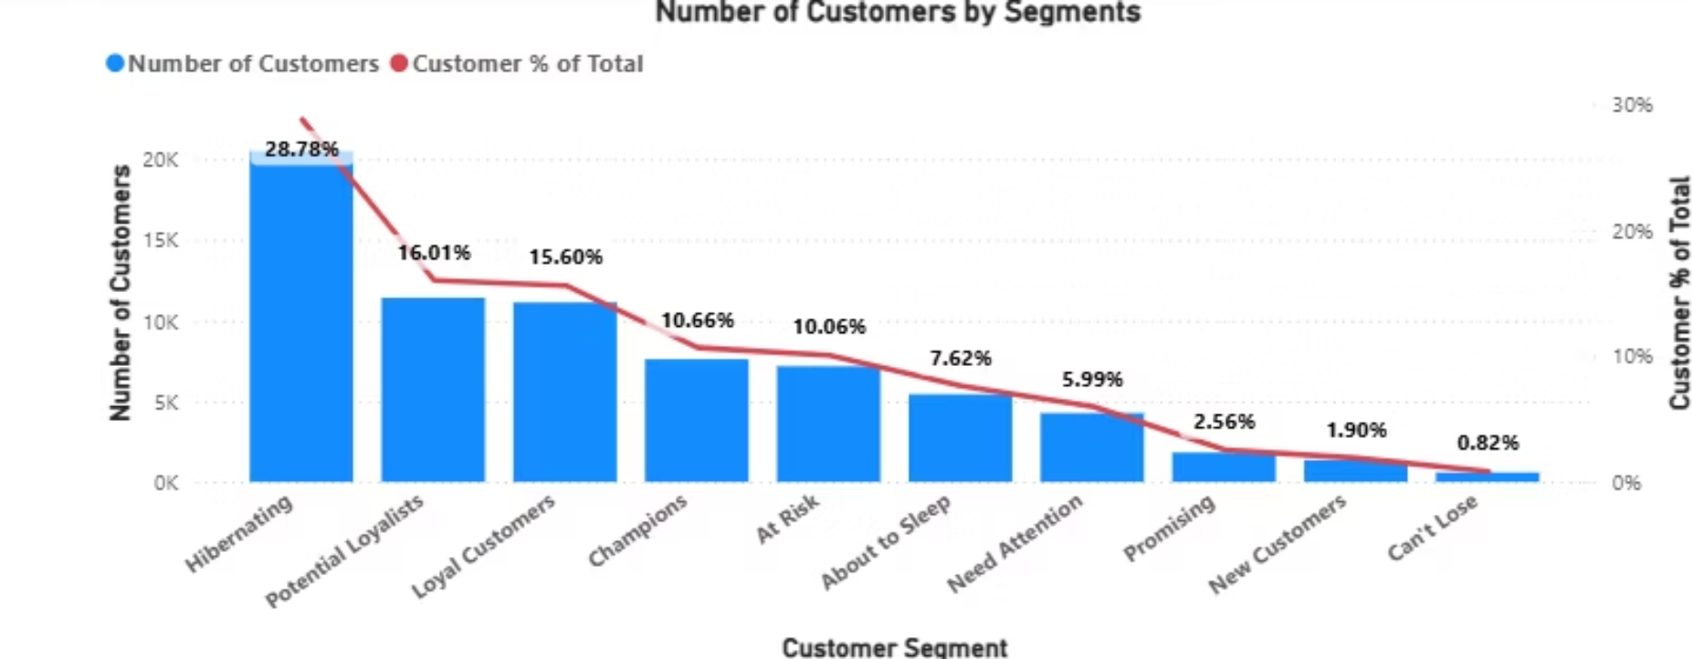
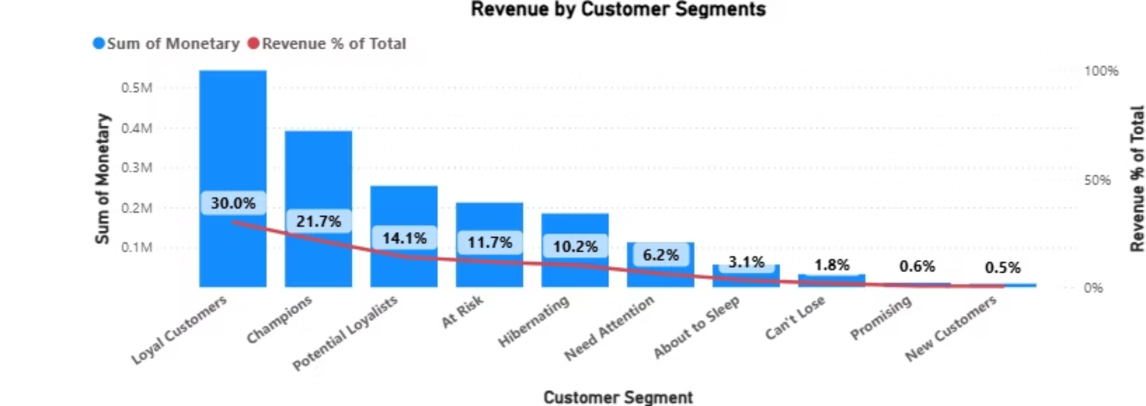
RFM Customer Behavior Analysis
Segment Highlights
Loyal Customers + Champions account for 50% of total revenue (~$930K) despite a smaller customer share — protect these segments at all costs.
Hibernating + At-Risk represent 40% of customers but only 30% of sales (~$400K) — high churn risk requiring reactivation campaigns.
Potential Loyalists contribute $250K (14%) today — targeted offers could double this to ~$500K with the right strategy.
Promising + New Customers contribute just $20K (1%) — onboarding offers and second-purchase discounts are essential to build early loyalty.

Slide 10
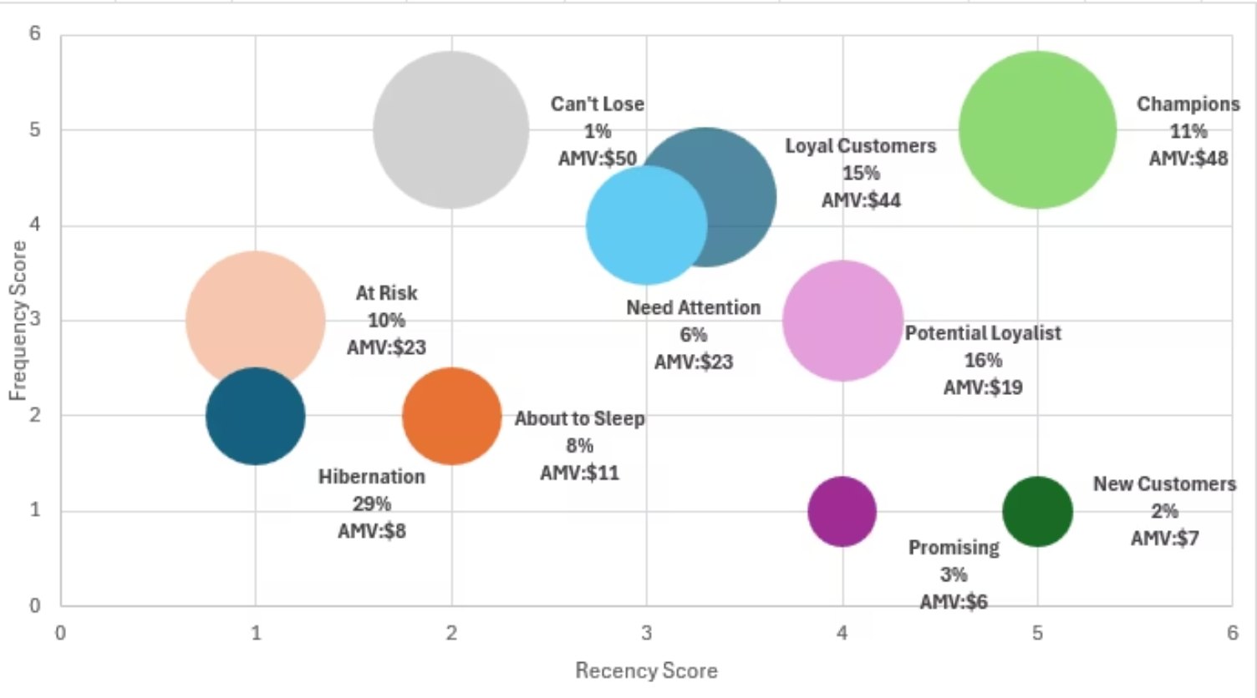

RFM Bubble Chart — Spend vs. Engagement
Strategic Priorities
Protect Champions & Loyalists
26% of customers, AMV $44–$48. Loyalty rewards and exclusive offers prevent churn in the highest-revenue cohort.
Reactivate Hibernating & At-Risk
39% of base, AMV $8–$23. Win-back campaigns targeting lapsed buyers represent the largest untapped revenue pool.
Nurture Potential Loyalists
22% of customers. Recent but infrequent — personalized reminders and targeted discounts can accelerate their path to loyal status.
Onboard New & Promising
AMV $6–$7. Strengthen the first-purchase experience and offer second-purchase incentives to convert acquisition into retention.

Slide 11

A/B Testing Pre-Setup
Establishing a rigorous foundation for a fair, data-driven retail trial across stores — February through April 2019.
Trial Design
1
Selected trial stores, defined the Feb–Apr 2019 trial window, and established a pre-trial baseline period for fair comparison.
Time Normalization
2
Created a YEARMONTH variable to enable consistent monthly-level analysis across all stores in the dataset.
Key Metrics
3
Calculated total sales, customer counts, transactions per customer, chips per transaction, and average price per unit.
Data Quality
4
Retained only stores with complete pre-trial and trial month data to ensure accurate and reliable baseline comparisons.

Slide 12
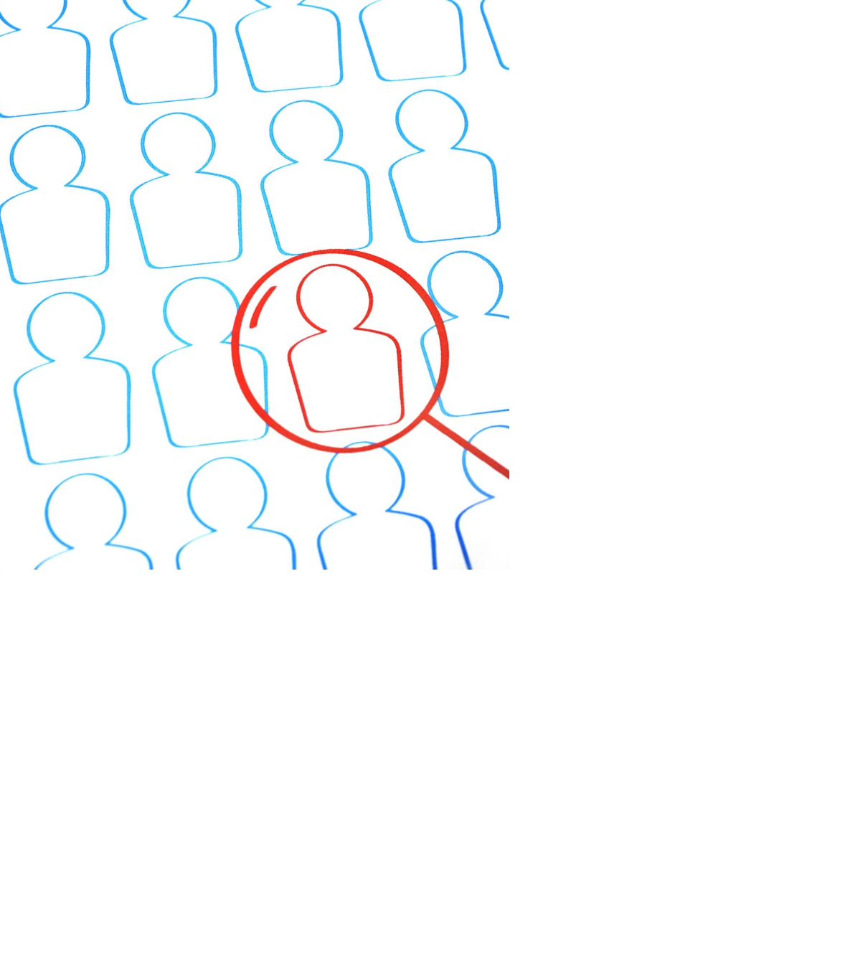
A/B Testing Store Matching Method
Control stores were selected using a two-part scoring framework to ensure pre-trial alignment with trial stores.
Multi-Metric Comparison
Evaluated all eligible stores on total sales, customers, transactions per customer, chips per transaction, and average price per unit.
Magnitude Distance
Measured absolute scale differences in monthly sales and customer counts, then standardized across months to reduce seasonal distortion.
Pearson Correlation
Confirmed trend similarity in historical sales and customer behavior patterns over the pre-trial period.
Final Selection
Chose stores with high correlation and low magnitude distance — aligned in both trend direction and business scale.

Slide 13
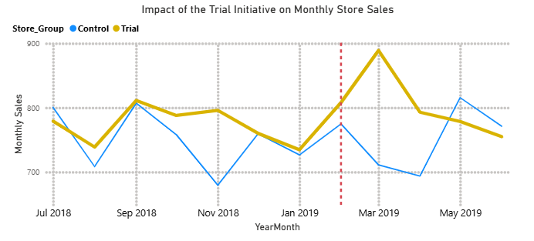
Sales Uplift Between Trial and Control Stores
February
+4% sales increase — trial stores begin pulling ahead of control stores after the initiative launches.
March
+25% peak uplift — highest observed gap of ~$180 between trial and control monthly sales.
April
+13% increase — uplift moderates but remains well above the pre-trial baseline trend.
Pre-Trial Alignment
Control and trial stores tracked the same seasonal pattern before Feb 2019, validating the matching method.

Slide 14
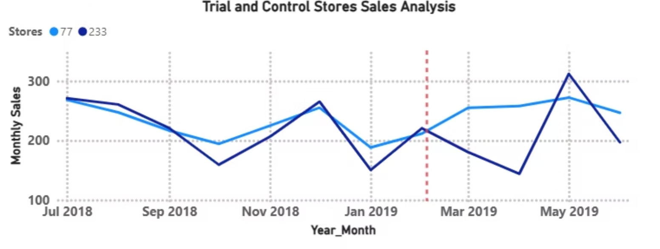
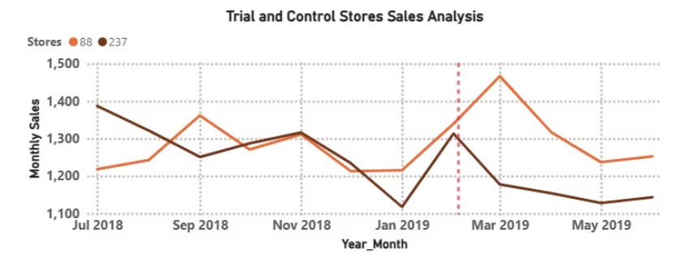
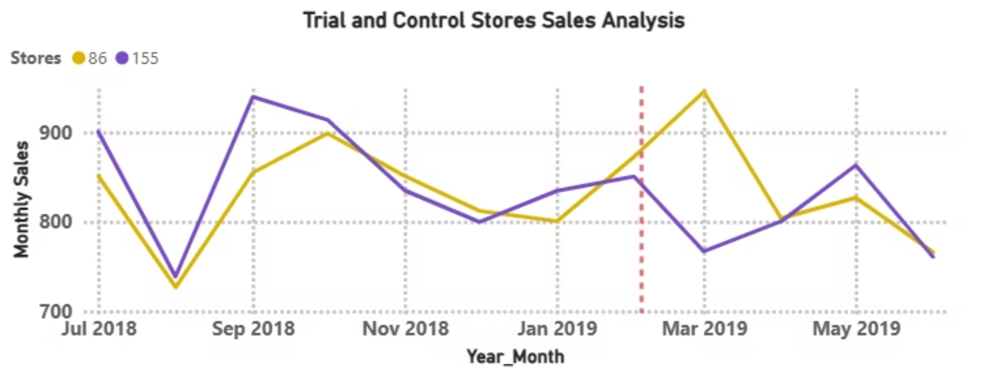

Revenue Lift Between Trial and Control Stores
All three trial–control pairs demonstrated consistent sales divergence after the trial start date (dashed red line), confirming the initiative's positive impact across different store scales.
Trial Store 77 vs. Control 233
Trial Store 86 vs. Control 155
Trial Store 88 vs. Control 237
Each pair tracks closely pre-trial, then diverges post-February — a clear signal of incremental lift attributable to the initiative.

Slide 15

Recommendations
Optimize Pricing & Bundling
Use average price per unit and chips-per-transaction insights to test multi-pack bundles in high-performing stores. Grow basket size rather than cutting prices to protect margins.
RFM-Based Targeted Promotions
Reward Champions and Potential Loyalists with personalized offers. Reactivate At-Risk and Hibernating customers with limited-time discounts and reminder messaging.
Convert One-Time Buyers
Identify New and Promising segments and deploy onboarding incentives such as second-purchase discounts. Track repeat purchase uplift as a primary KPI.
Institutionalize A/B Testing
Continue using matched controls and pre-trial validation for all major changes. Focus decisions on measurable incremental uplift — not raw sales — to ensure causality and ROI.

Slide 16
Thank You
Cyril Obeng-Darko
📞 +44 7389 170658
✉️ cyrilobeng7@gmail.com

